Slide 1
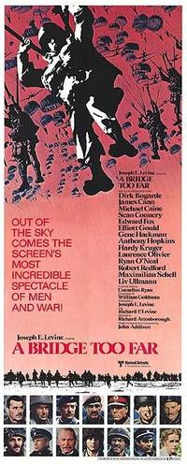
A Bridge Too Far

Slide 2
Facts
Director: Richard Attenborough
Type of film: war epic movie
Historical settings: The Netherlands in 1944
Market Garden operation

Slide 3
Cast
- Dirk Bogarde as Lieutenant General Frederick Browning, commander of the 1st Allied Airborne Army
- Michael Caine as Lieutenant Colonel John Vandeleur, commander of the British XXX Corps of the Irish Guards
- Sean Connery as Major General Robert "Roy" Urquhart, commander of the British 1st Airborne Division
- Gene Hackman as Brigadier General Stanisław Sosabowski, commander of the Polish 1st Independent Parachute Brigade
- Edward Fox as Lieutenant General Brian Horrocks, commander of the British XXX Corps
- Elliott Gould as Colonel Robert Stout - Anthony Hopkins as Lieutenant Colonel John D. Frost, Commander of the 2nd Battalion, British 1st Airborne Division
- Ryan O'Neal as Brigadier General James Gavin, commander of the 82nd Airborne Division

Slide 4
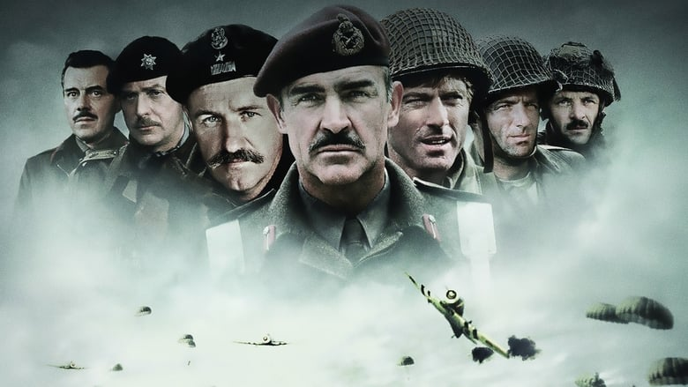

Slide 5
Awards and nominations
Award | Category | Nominee | Result
Evening Standard British Film Awards | Best film | A Bridge Too Far | Won
31st British Academy Film Awards | Best Direction | Richard Attenborough | Nominated
31st British Academy Film Awards | Best Editing | Antony Gibbs | Nominated
31st British Academy Film Awards | Best Sound | Peter Horrocks, Gerry Humphreys, Simon Kaye, Robin O'Donoghue, and Les Wiggins | Won
31st British Academy Film Awards | Best Cinematography | Geoffrey Unsworth | Won
31st British Academy Film Awards | Best Film Music | John Addison | Won
1977 National Society of Film Critics Awards | Best Supporting Actor | Edward Fox | Won

Slide 6
Short description of the film
This war drama film was based on the novel of the same name by Cornelius Ryan and turned into film in 1977.
The film presents the preparation, course and the consequences of the operation of American, British and Polish troops under the code name "Market Garden". The title comes from the words of General Browning: "I think maybe we are planning one bridge too far." The Dutch city of Deventer played an important role: the bridge there pretended to be the bridge in Arnhem, and the market square – the market square in Eindhoven.

Slide 7
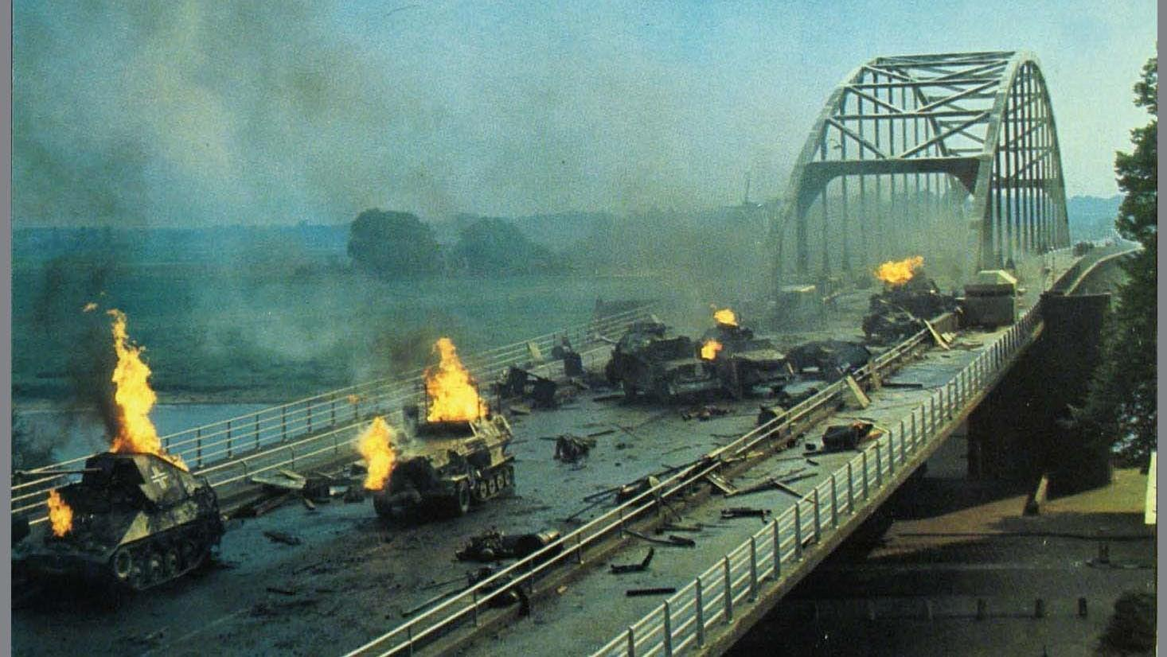

Slide 8
Market Garden
Market Garden operation was only partly successful.
Due to wrong estimates of Marshal Montgomery, his insufficient recognition of enemy forces and bad weather conditions, thousands of lives were taken and a lot of buildings and bridges wiped out.

Slide 9
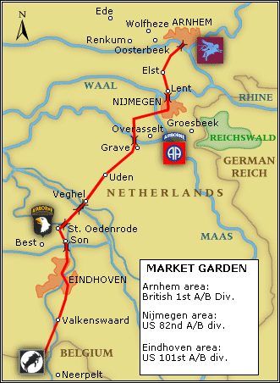

Slide 10
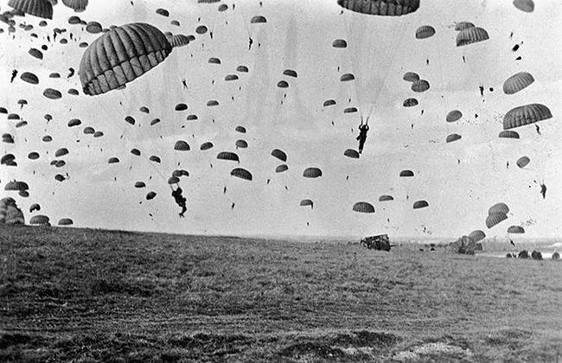
Airborne Brigade of general S. Sosabowski – patron of Polish school – is landing
Near Arnhem

Slide 11
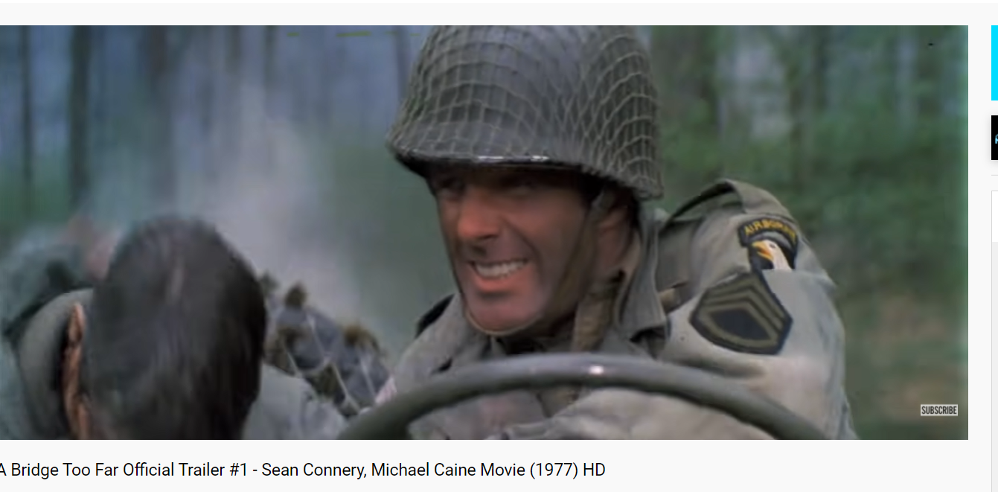
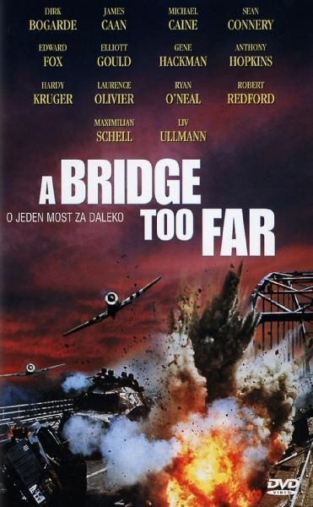
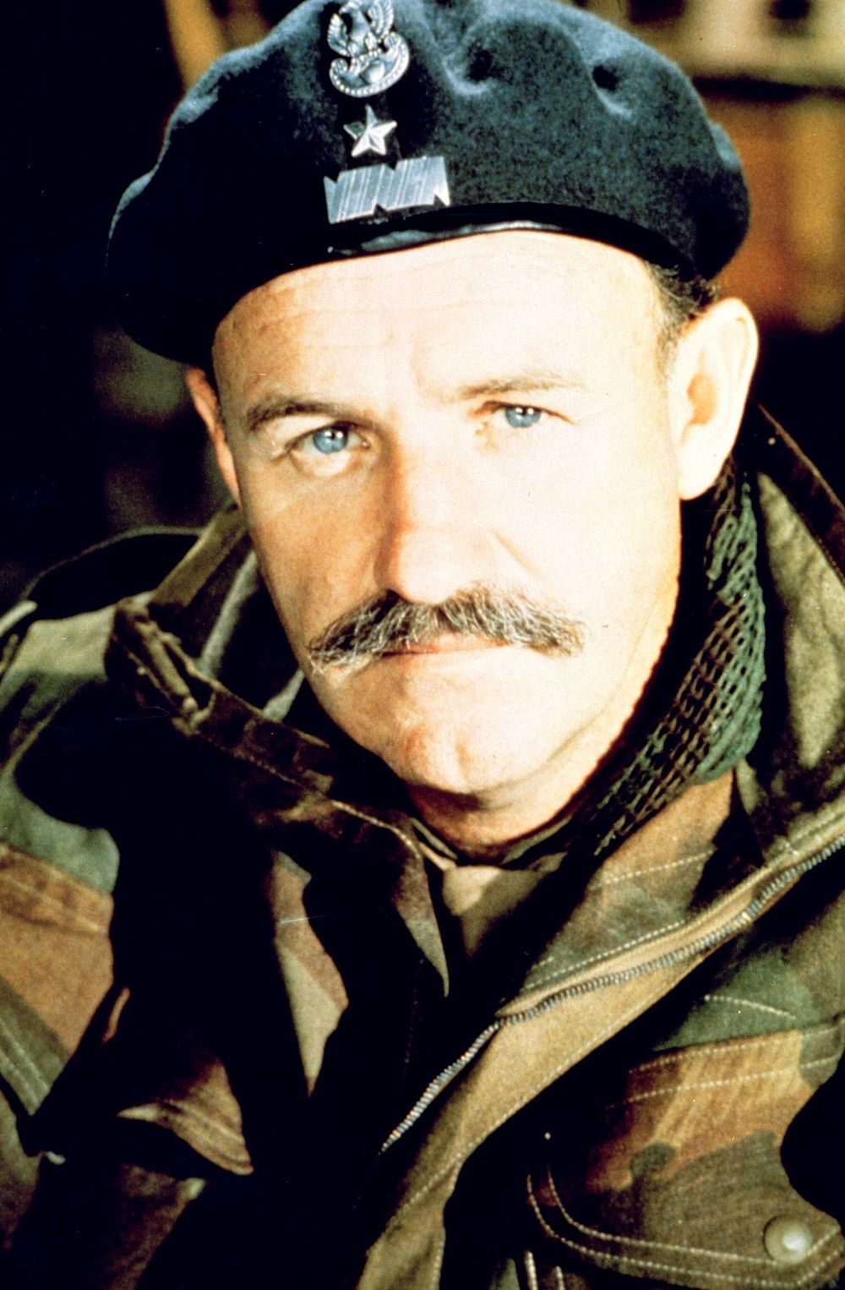

Slide 12
Interesting facts
Representatives of each nation in the film use their own language, German dialogues are in German, Dutch in Dutch, Polish - in Polish.
John Addison, musician for the film, served in the XXX Corps during World War II.
Only four M4 Sherman tanks are real in the film, the rest of the armored vehicles seen on the screen are plastic models on a Volkswagen Beetle chassis.

Slide 13
Reception
Critics agreed that the film was impressively staged. and historically accurate, although many found it too long and too repetitive.
We strongly recommend it

Slide 14
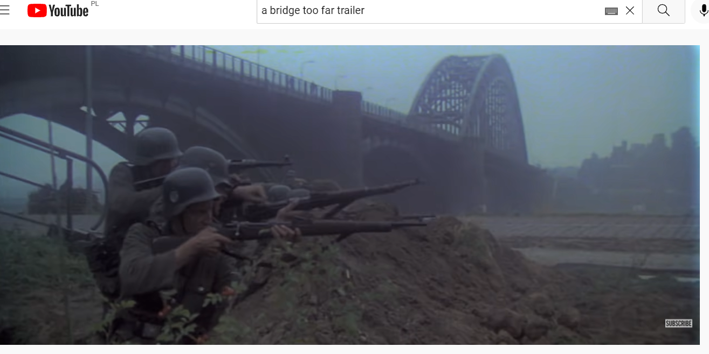
Watch the trailer
https://youtu.be/AWL184ZcSxA

